Slide 1

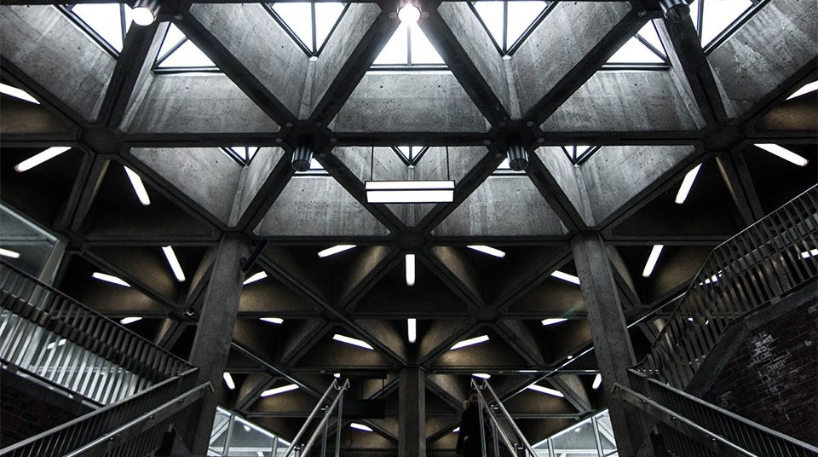
Stock Predictions with Machine Learning
2
+
2
+
Duvan Diaz
Akibo Watson

Slide 2


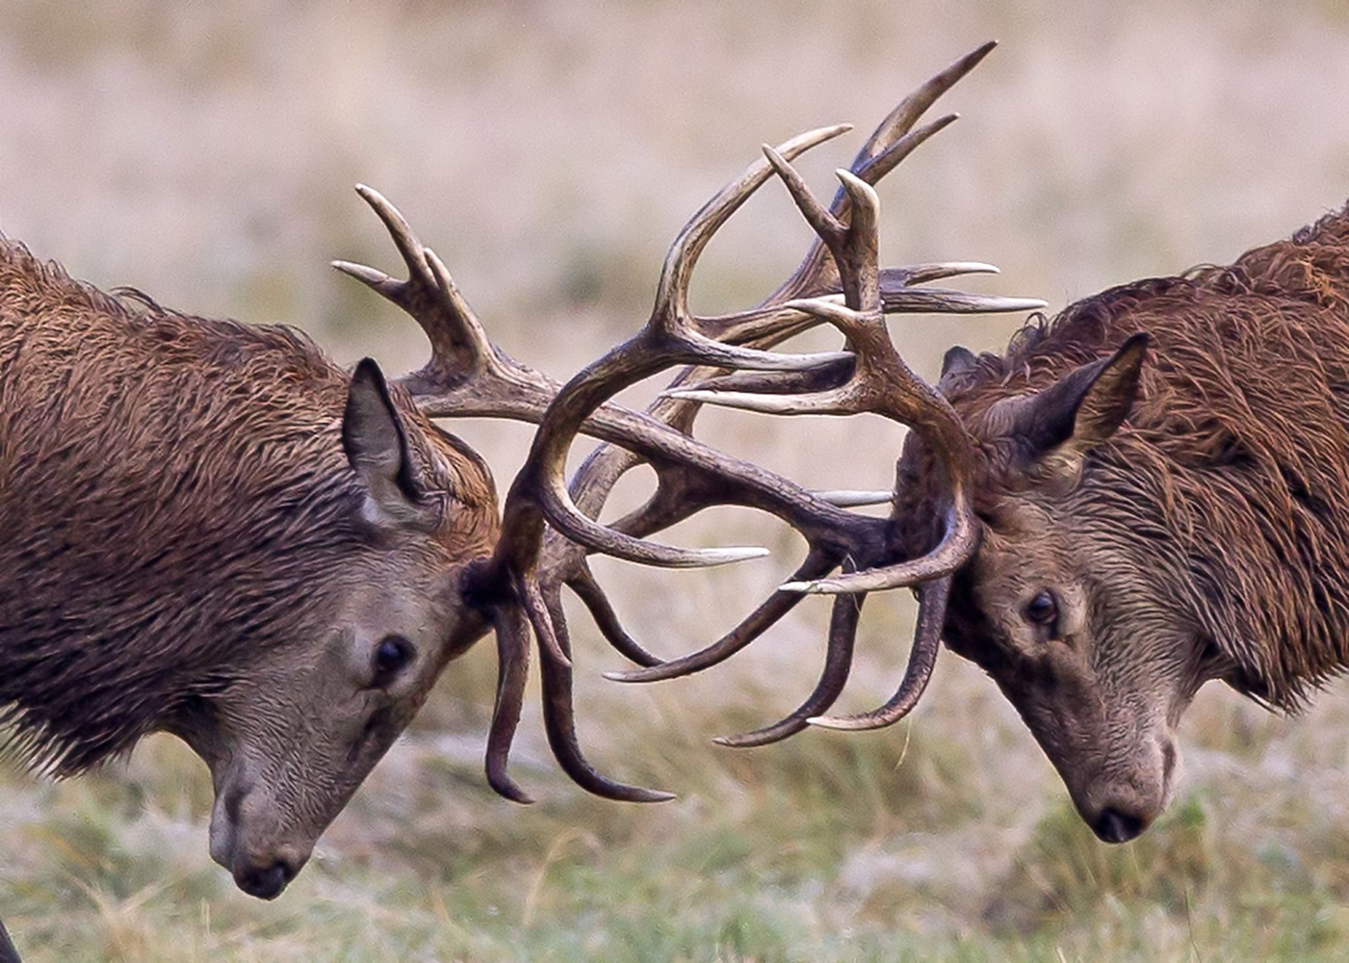
The Problem
The Solution
2
+
2
+
Poor market hypotheses
Unpredictable investment environment
Irrational market participants
Barriers to entry for smaller investors
Harder to gain an “edge”
Machinery that can accurately navigate uncertain environments
Market hypotheses that are resilient to market irrationalities
Consistency in investment returns
2
+
2
+

Slide 3
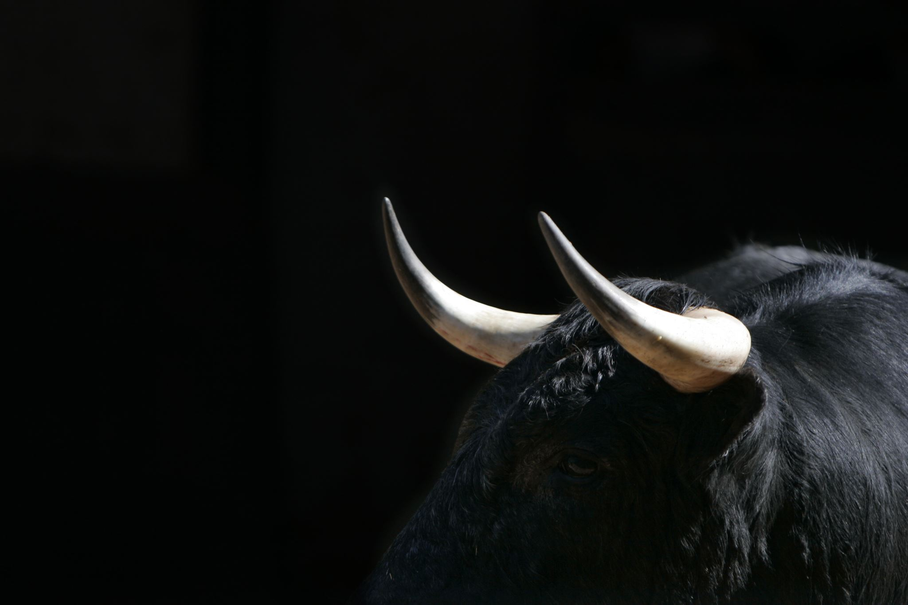
Analyzing the Market
2
+
Tools used to help predict price action:
Fundamental Analysis
Debt/Equity Ratio
Revenue
Market share
Efficient Market Hypothesis
All necessary information is accounted for in the price
Price action, Trading Volume
Python / Machine Learning

Slide 4
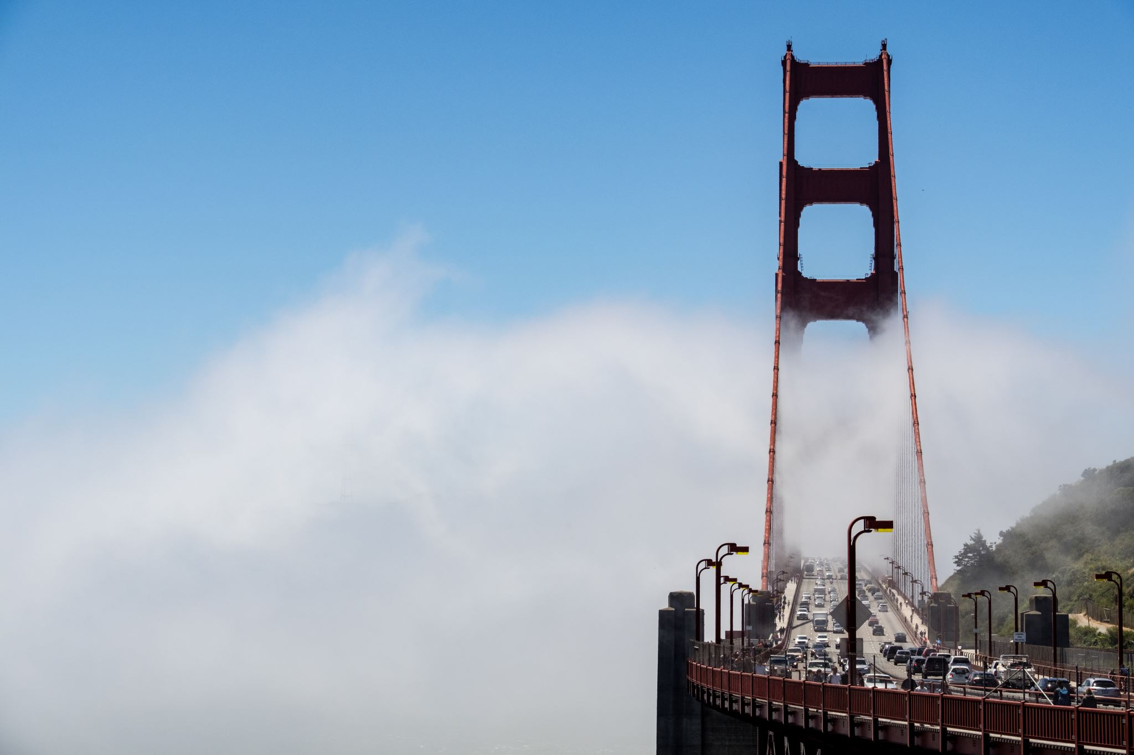
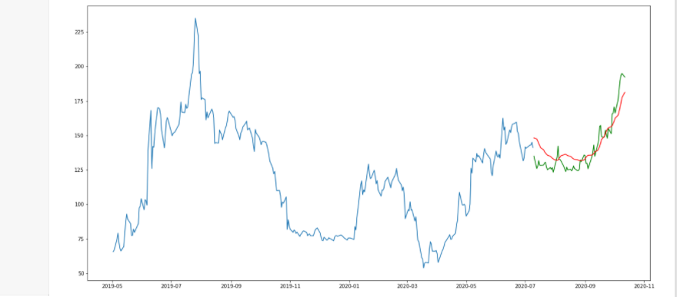
Machine Learning with Python In order to create the model, we had to use a mixture of SKlearn, Keras, and Matplotlib, Plotly Dashboard, to test and train our data. This is what the model looks like when tested. By using moving averages to predict the data, we can get an estimate of where the price will go based on just the price.
2
+

Slide 5
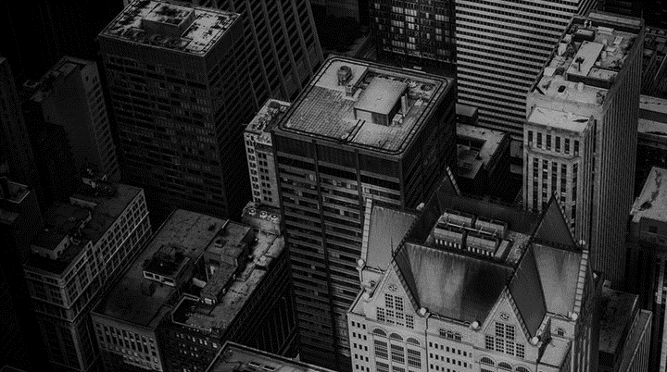
Application Presentation
2
+
2
+
2
+

Slide 6
THANK YOU
2
+
2
+

